Slide 1
Unit 1 Live Session
Andrew Leppla

Slide 2
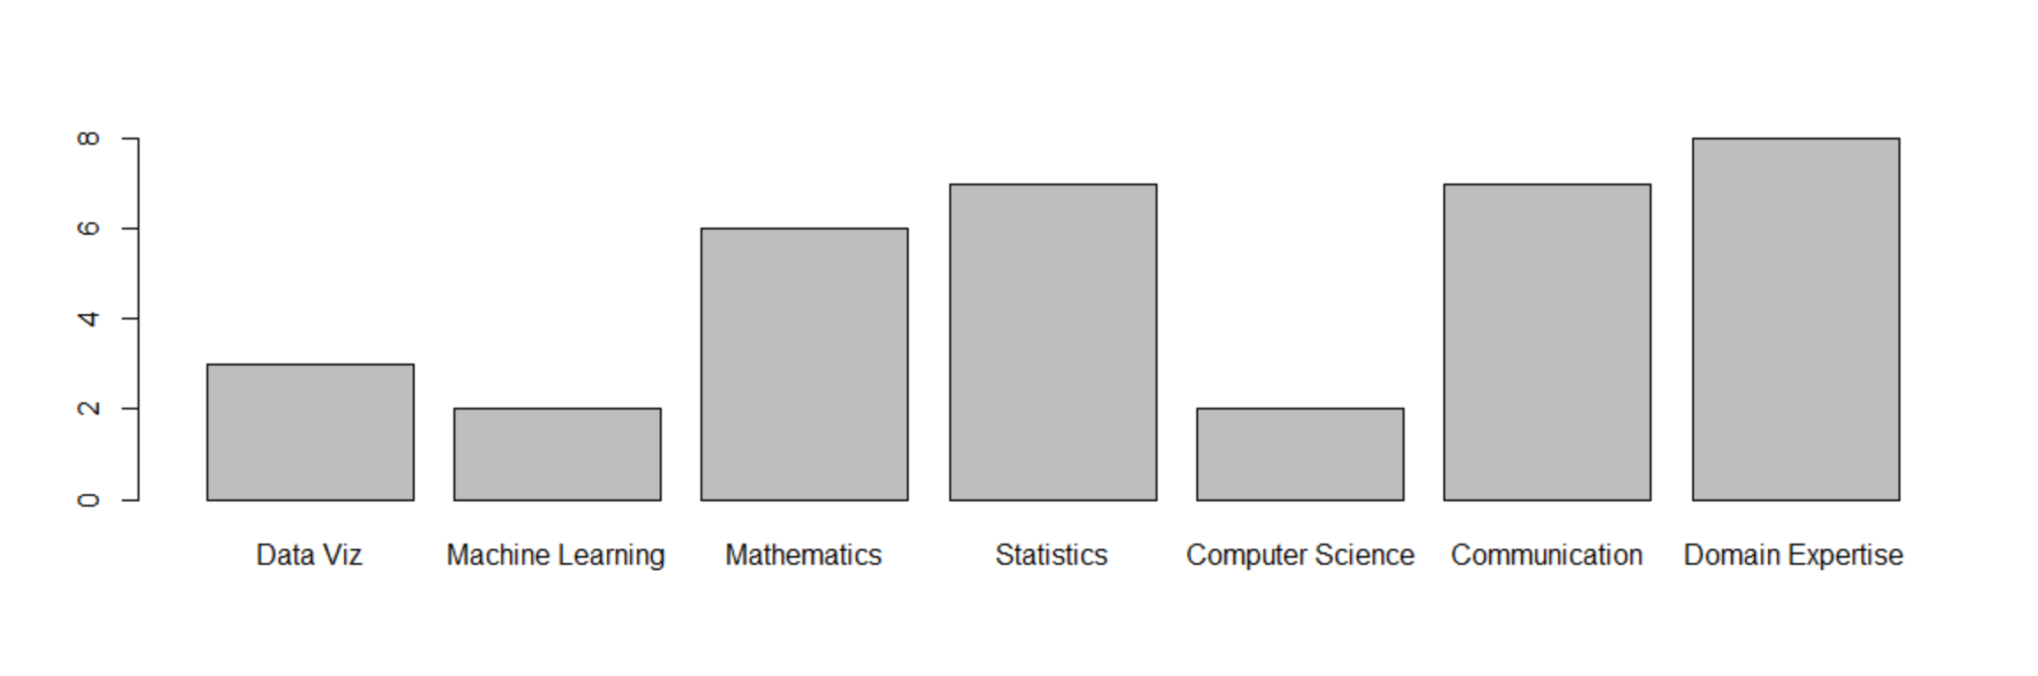
1. Andrew's Data Science Profile

Slide 3
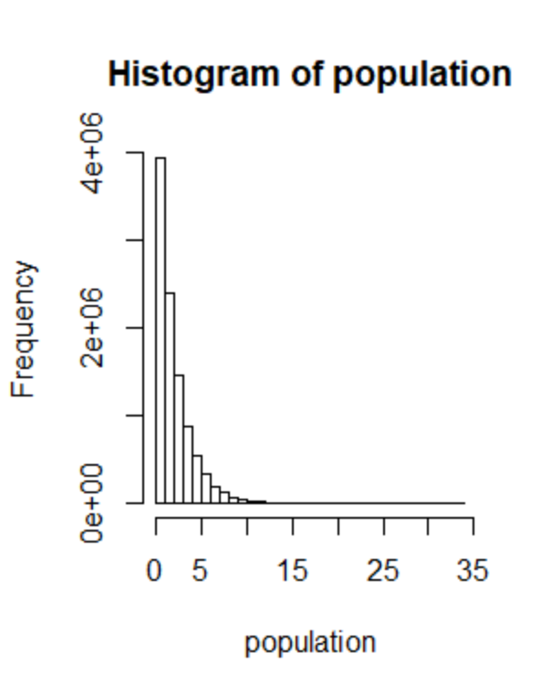
2.1 and 2.2
> population = rchisq(10000000,2,ncp=0) > hist(population)

Slide 4
2.3 and 2.4
> mean(population) [1] 2.000625 > sd(population) [1] 2.001192
The distribution of the sample means should be approximately normal.
mean_50 = mean_Population
SE_mean_50 = sd_Population/sqrt(50)

Slide 5
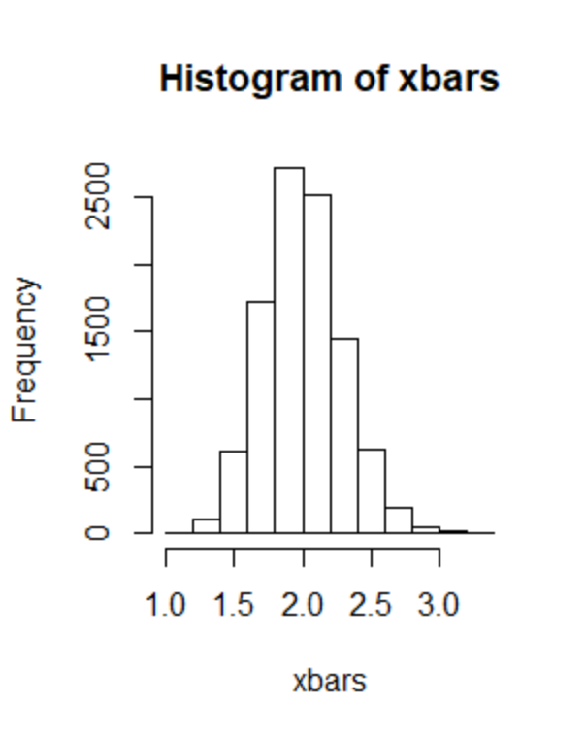
2.5 and 2.6
> xbars = xbarGenerator(50,10000) > length(xbars) [1] 10000 > hist(xbars) > mean(xbars) [1] 1.999933 > sd(xbars) [1] 0.2822817

Slide 6
3. Six Step Hypothesis Test
H0: µ = 21, Ha: µ ≠ 21
t_crit (0.975,6) = 2.45
t_value = 3.31
P(t_value > t_crit) = 0.016
Reject H0
In conclusion, there is sufficient evidence to suggest that the mean age of patrons at the Beach Comber is not equal to 21 (p = 0.016, 2-sided 1-sample t-test). The 95% confidence interval is [23.3,36.4] years old. Since patrons were chosen at random, this finding can be generalized to all Beach Comber patrons leaving at 7PM on that day.

Slide 7
3. R Code and Output
> Patrons = c(25,19,37,29,40,28,31) > t.test(Patrons,mu=21) One Sample t-test data: Patrons t = 3.3093, df = 6, p-value = 0.01622 alternative hypothesis: true mean is not equal to 21 95 percent confidence interval: 23.30816 36.40613 sample estimates: mean of x 29.85714
> qt(.975,6) [1] 2.446912

Slide 8
4. Takeaways and/or Questions
My biggest takeaways are that Git and GitHub are really powerful and useful, especially when combined with RStudio. However, trying to get everything to work behind a firewall and other security settings is PAINFUL! Hours of pain!
No major questions this week after I finally got everything working.

